Slide 1
OpenDSS Training Workshop
University of Puerto Rico - Mayaguez
Roger C. Dugan
Sr. Technical Executive
EPRI Knoxville, TN
January 21-22, 2019

Slide 2
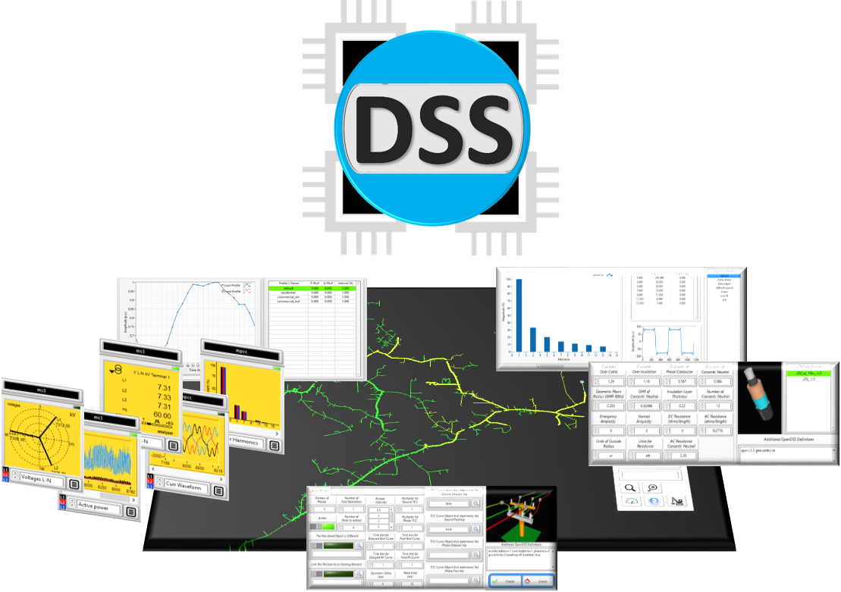
Introduction to OpenDSS-G

Slide 3
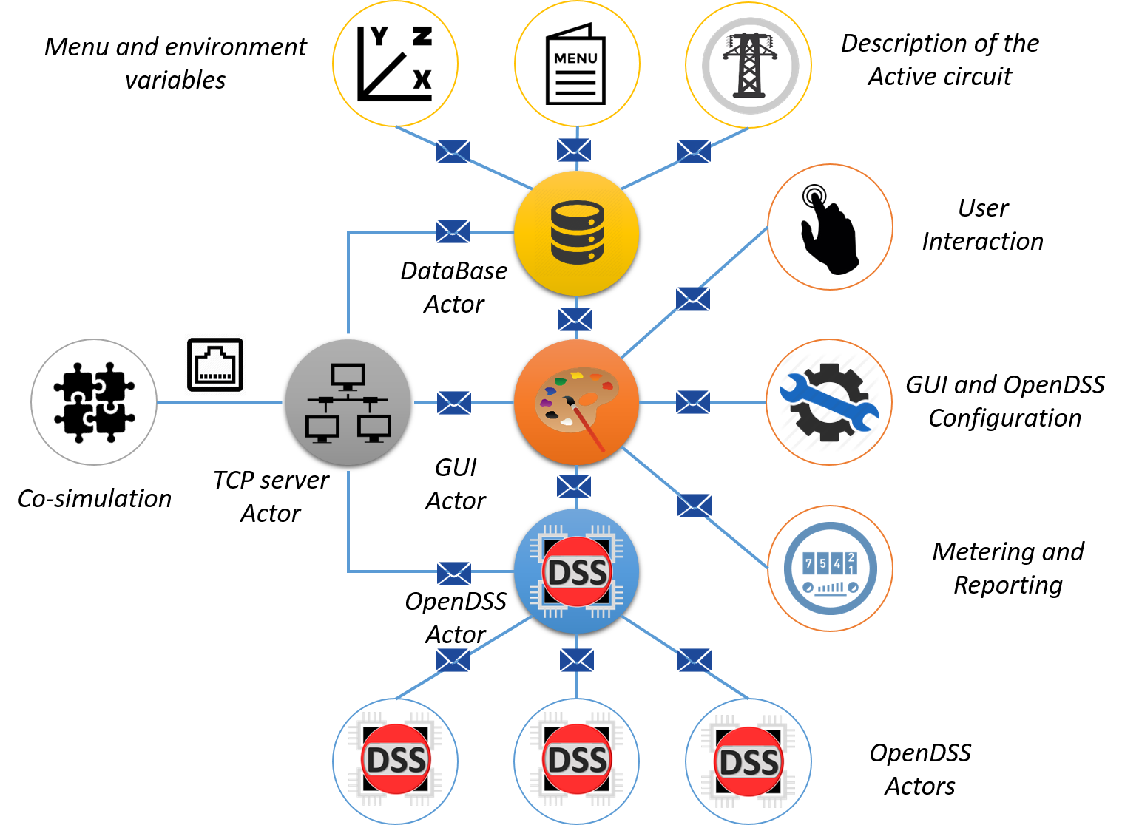
Introduction to OpenDSS-G

Slide 4
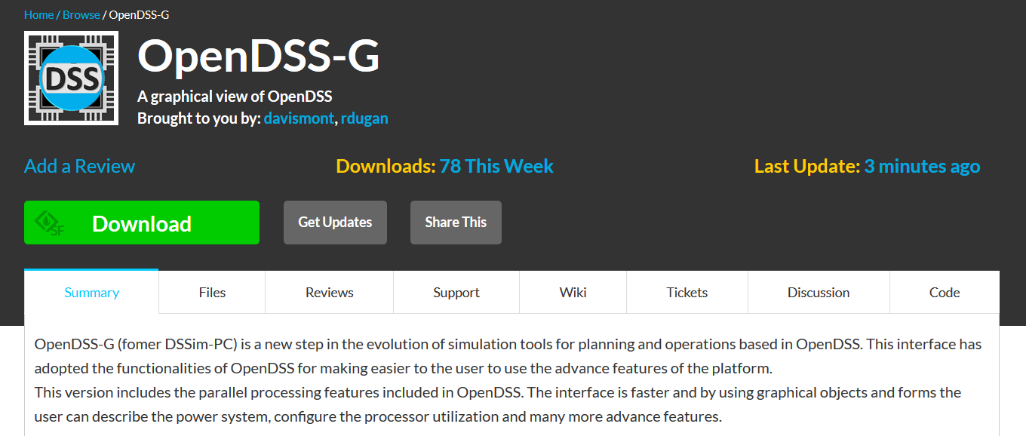
Installing OpenDSS-G
Download the installer from:
https://sourceforge.net/projects/dssimpc/

Slide 5
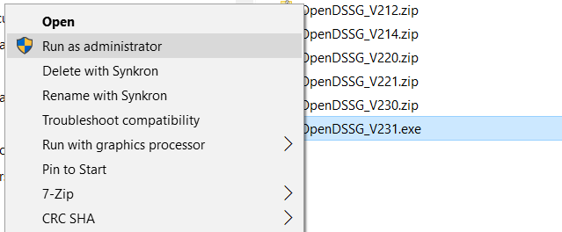
Installing OpenDSS-G
2. To run the installer:
Right click -> Run as administrator

Slide 6
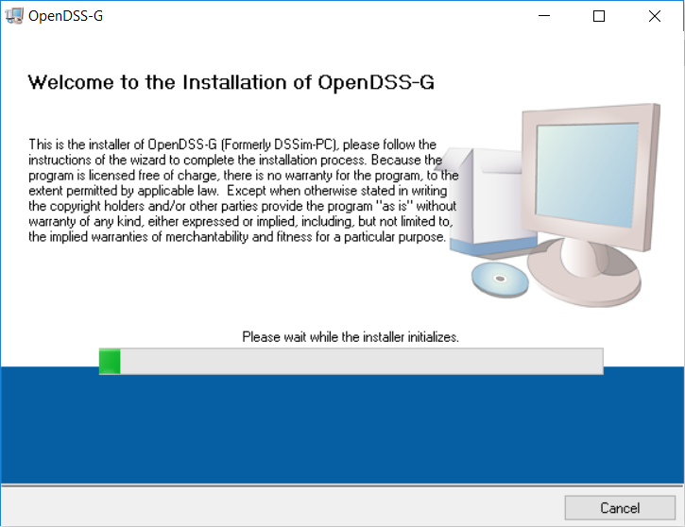
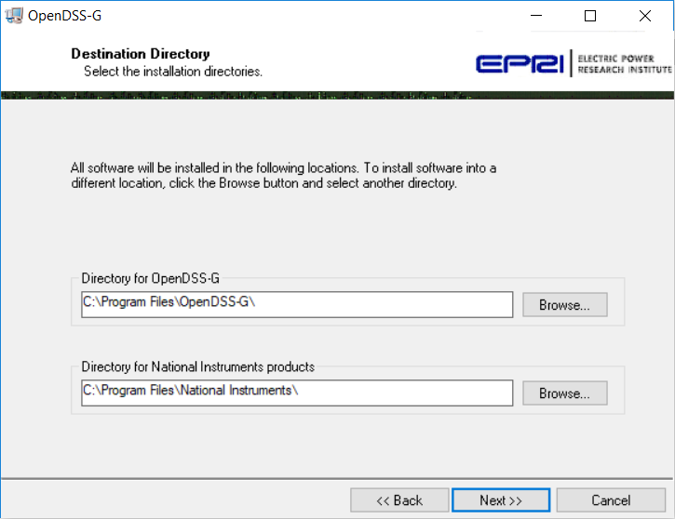
Installing OpenDSS-G
3. Follow the instructions:

Slide 7
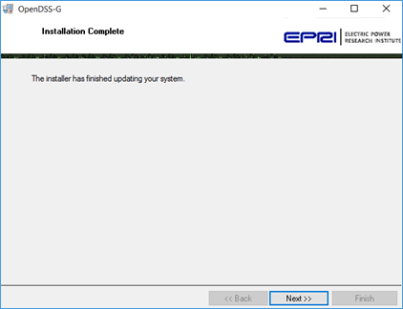
Installing OpenDSS-G
4. First part completed

Slide 8
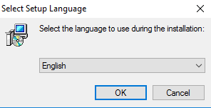
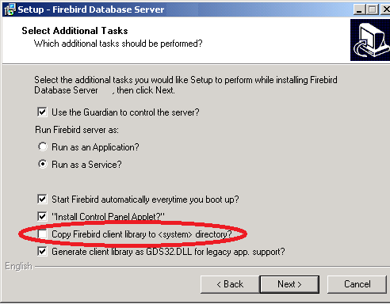
Installing OpenDSS-G
5. Install the database

Slide 9
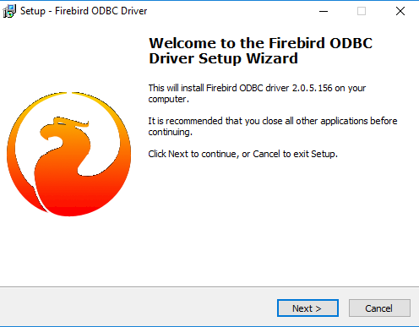
Installing OpenDSS-G
6. Install the ODBC

Slide 10
Installing OpenDSS-G
7. You are done!
If there is any issue, go to the troubleshooting section at the OpenDSS-G manual

Slide 11
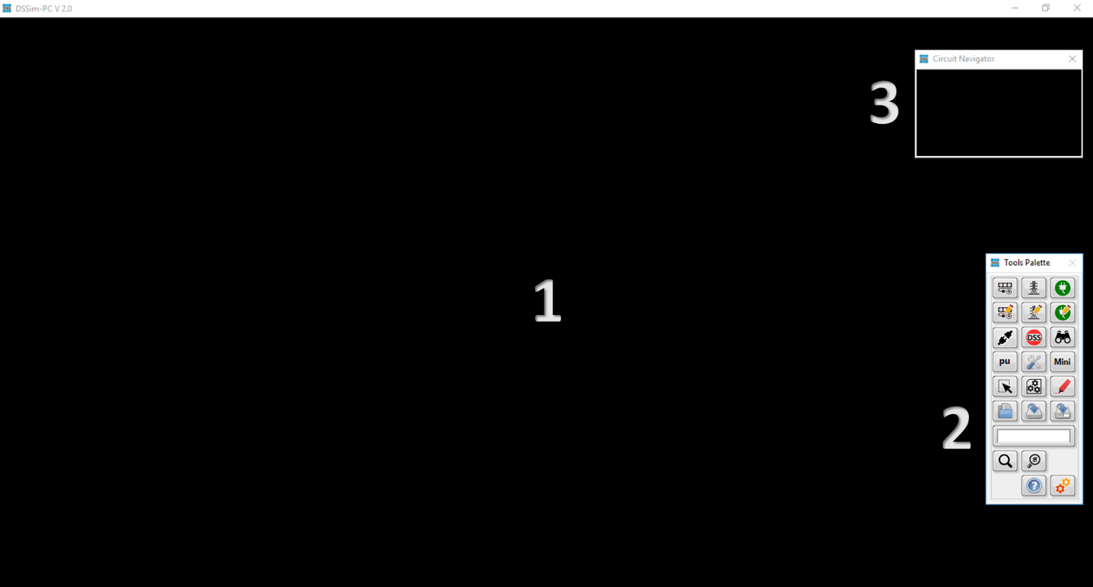
Introduction to OpenDSS-G

Slide 12
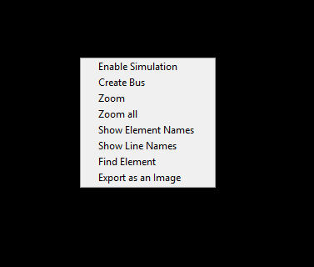
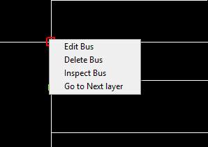
Introduction to OpenDSS-G

Slide 13
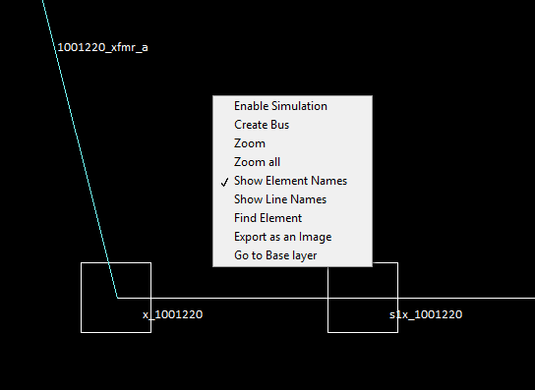
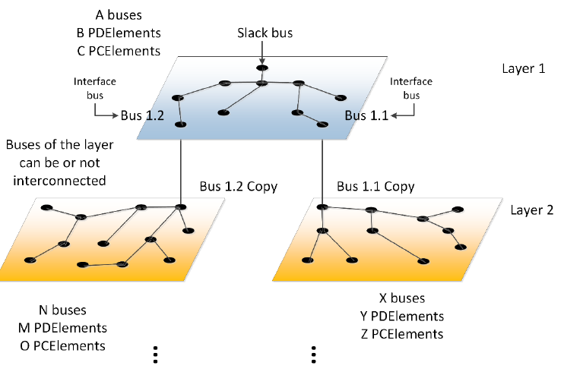
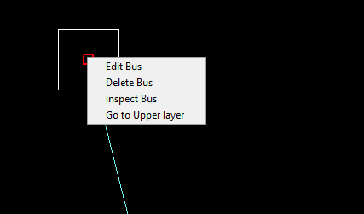
Introduction to OpenDSS-G

Slide 14
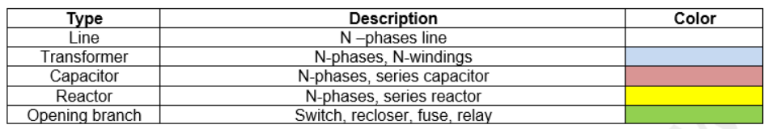
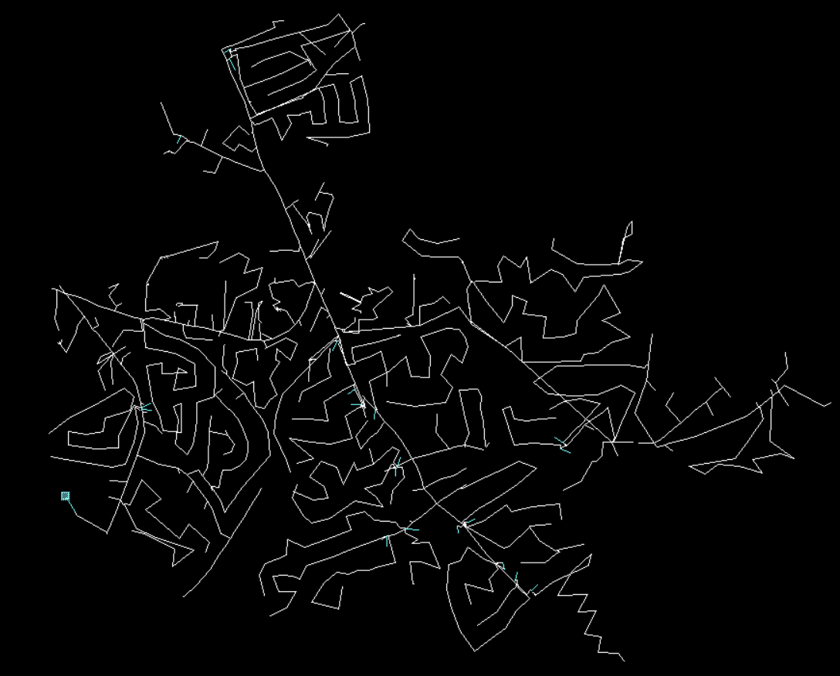
Introduction to OpenDSS-G

Slide 15
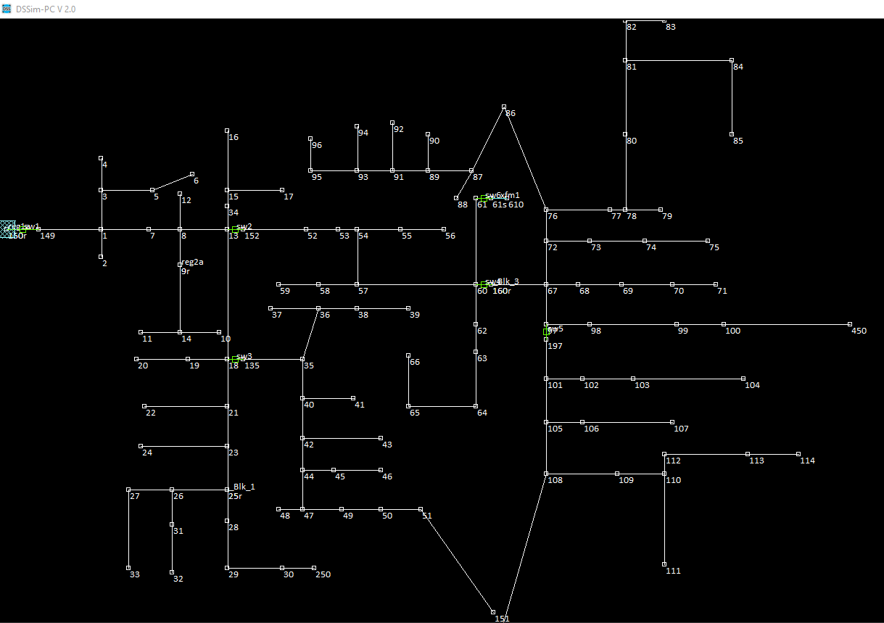
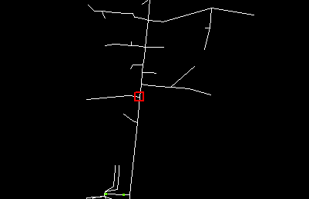
Introduction to OpenDSS-G

Slide 16
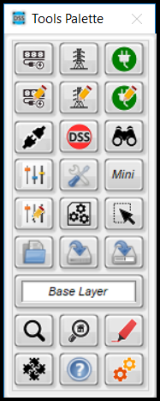
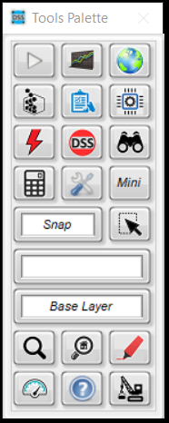
Introduction to OpenDSS-G

Slide 17
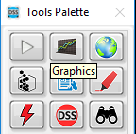

Introduction to OpenDSS-G

Slide 18
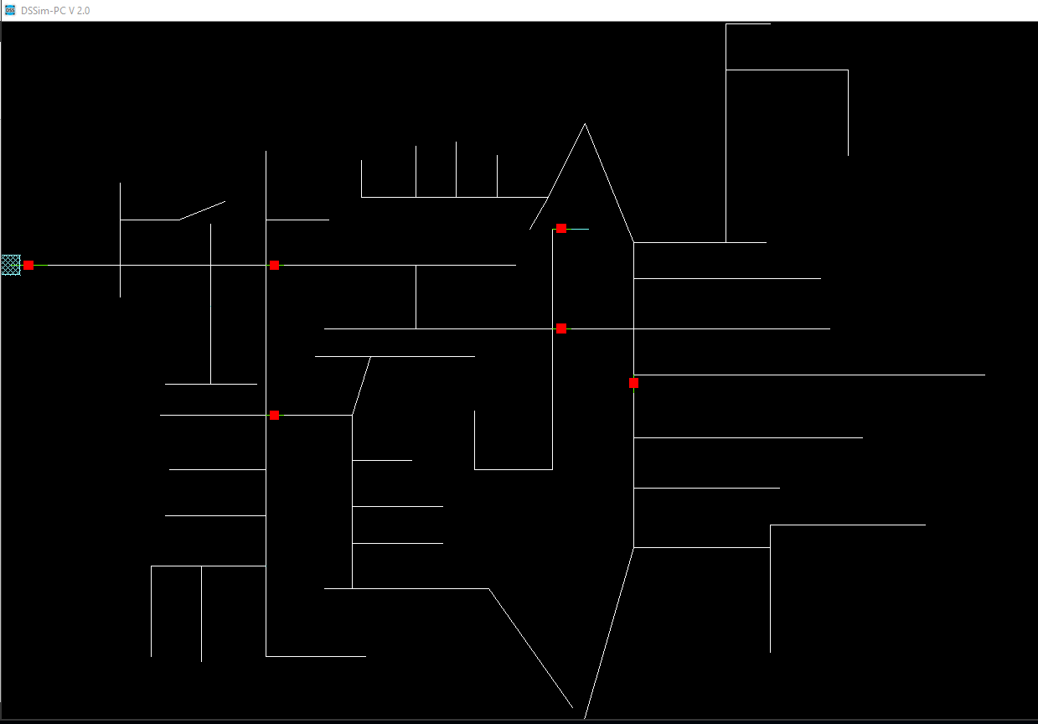
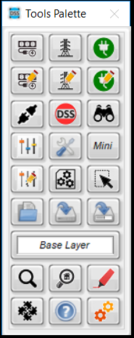
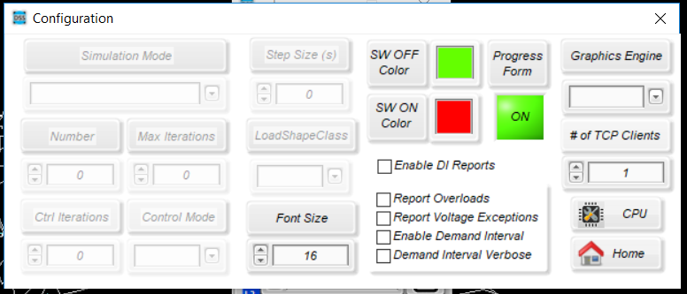
Introduction to OpenDSS-G

Slide 19
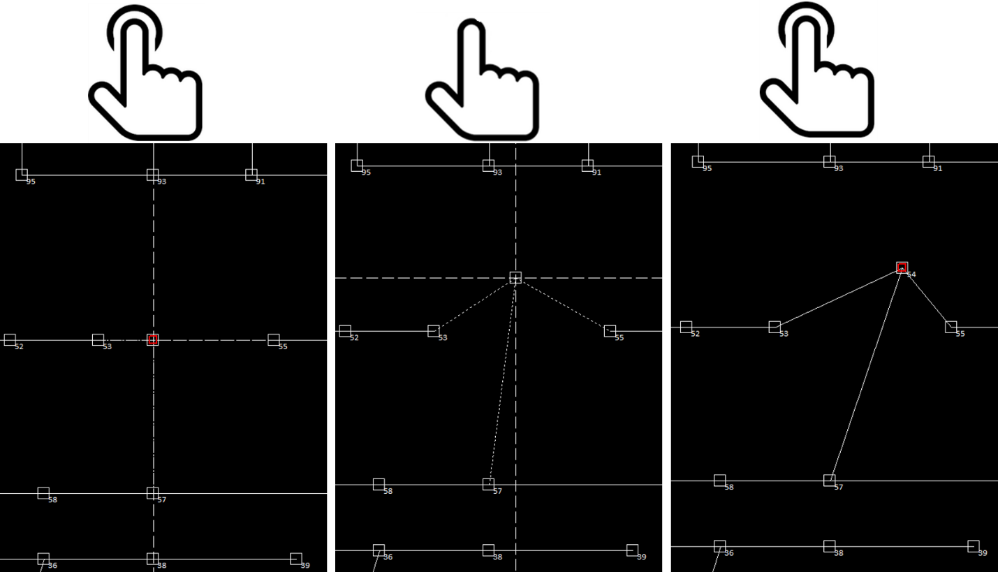
Introduction to OpenDSS-G

Slide 20
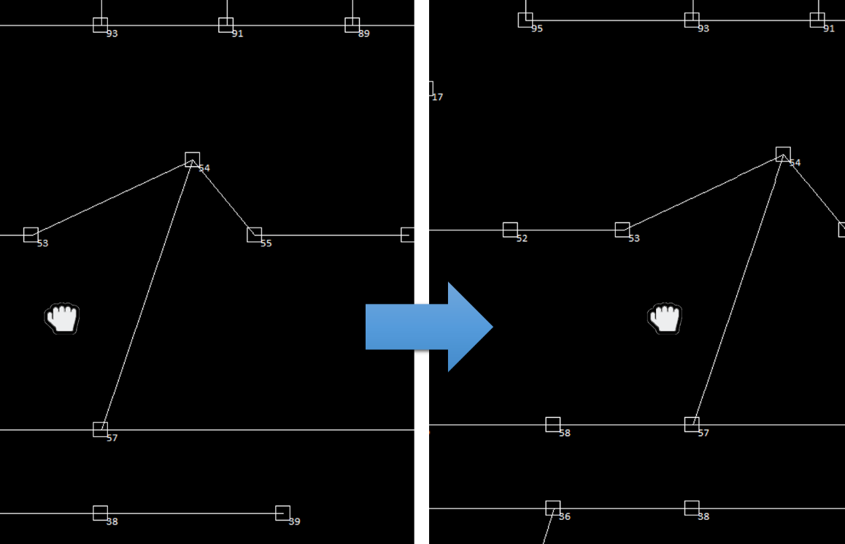
Introduction to OpenDSS-G

Slide 21
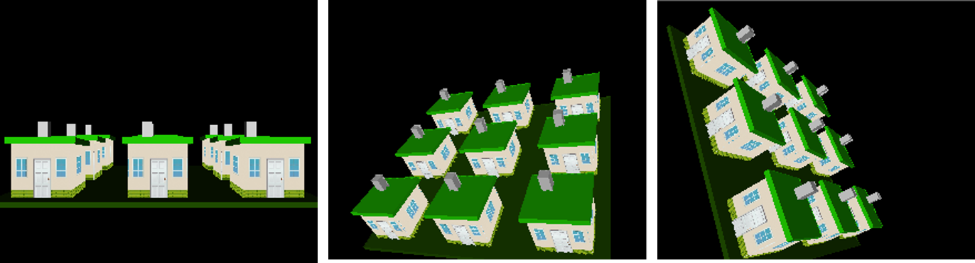
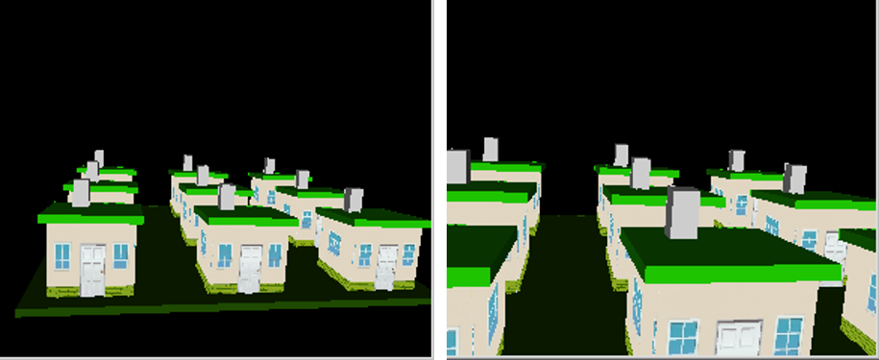
Introduction to OpenDSS-G

Slide 22
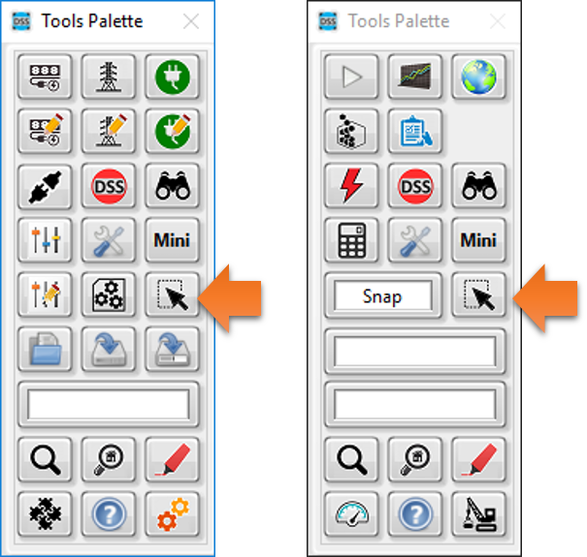
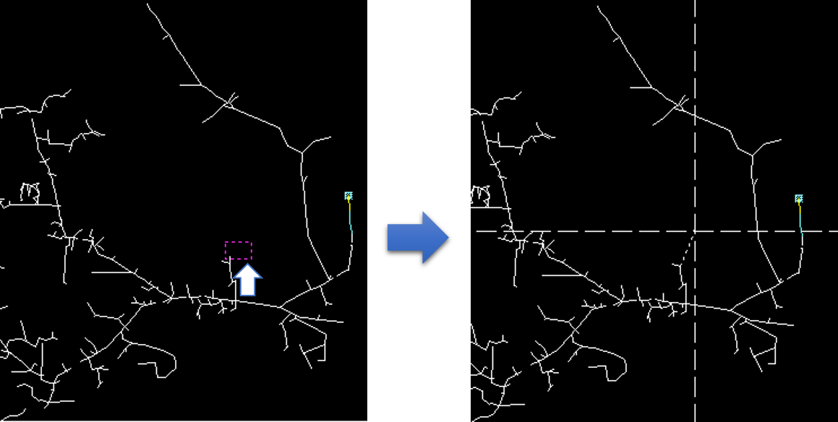
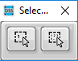
Introduction to OpenDSS-G

Slide 23
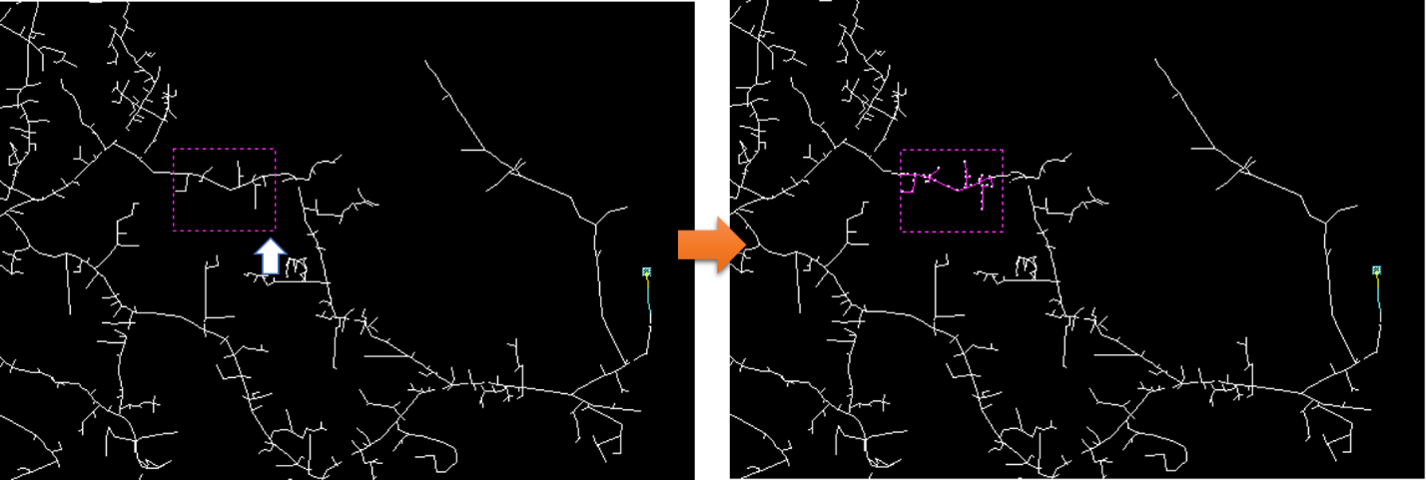
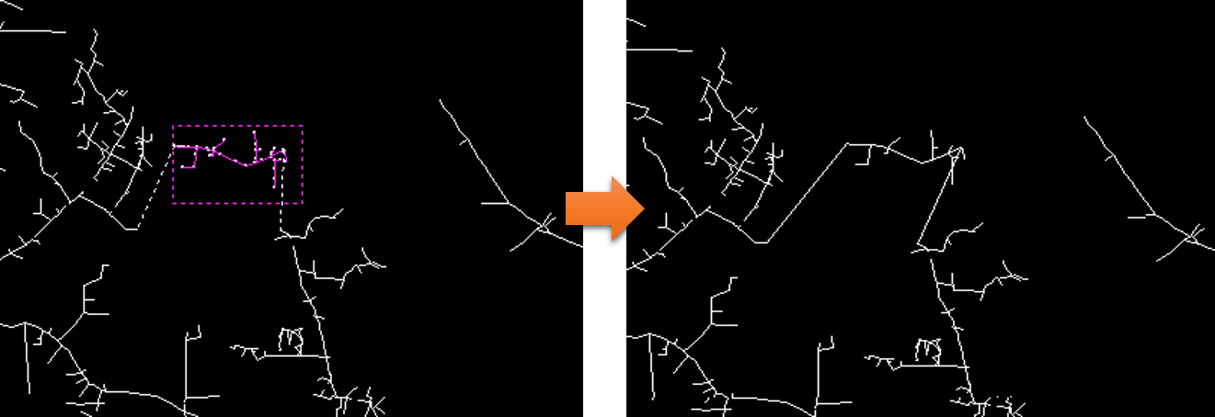
Introduction to OpenDSS-G

Slide 24
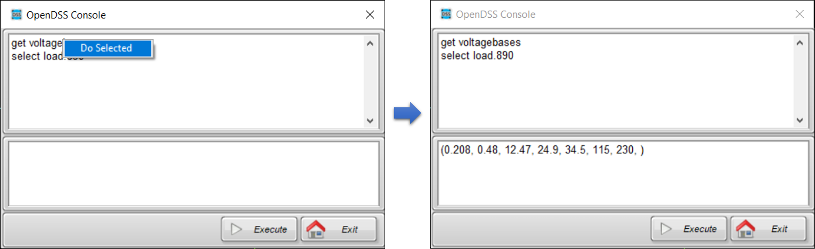
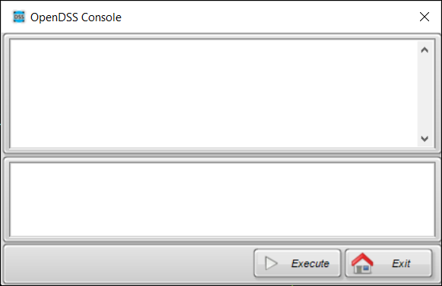
Introduction to OpenDSS-G

Slide 25
Creating your model
You have 2 options:
Importing an existing model
Describing your circuit from the scratch

Slide 26
Before anything
Download the examples to be used in this session:
https://sourceforge.net/p/dssimpc/code/HEAD/tree/trunk/Distribution/Examples/

Slide 27
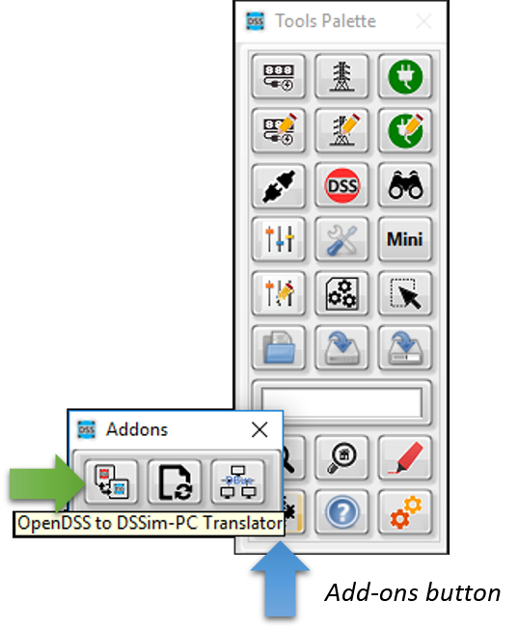
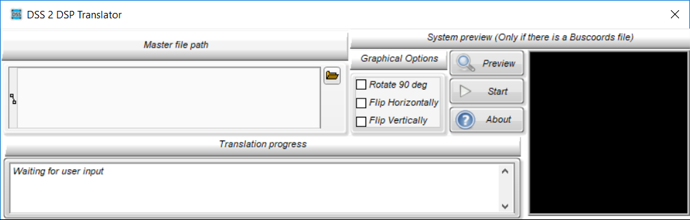
Importing a model

Slide 28



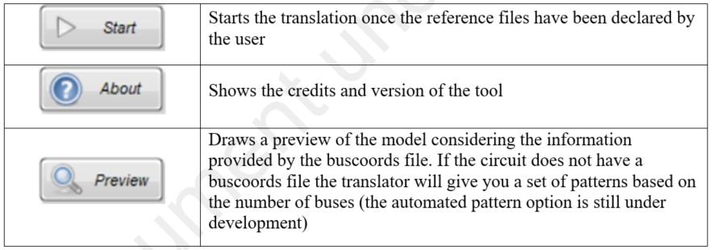
Importing a model

Slide 29
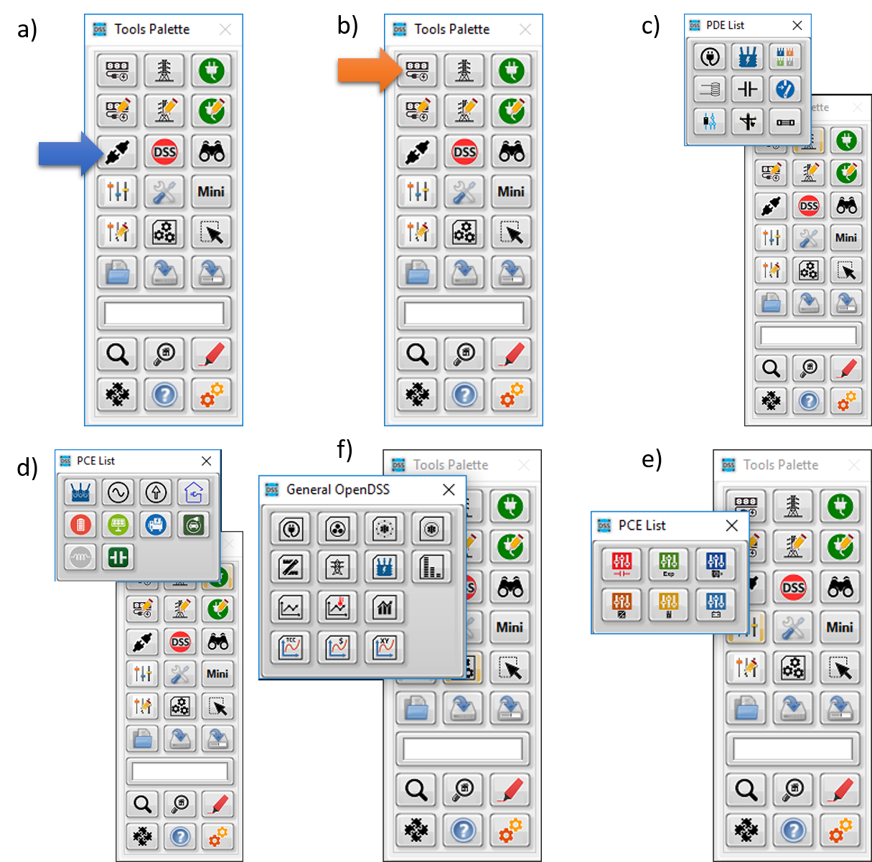
Creating the model from the scratch

Slide 30
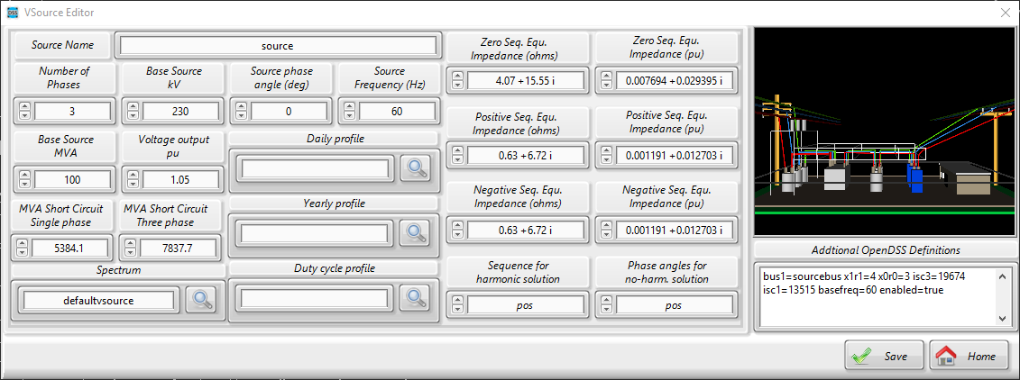
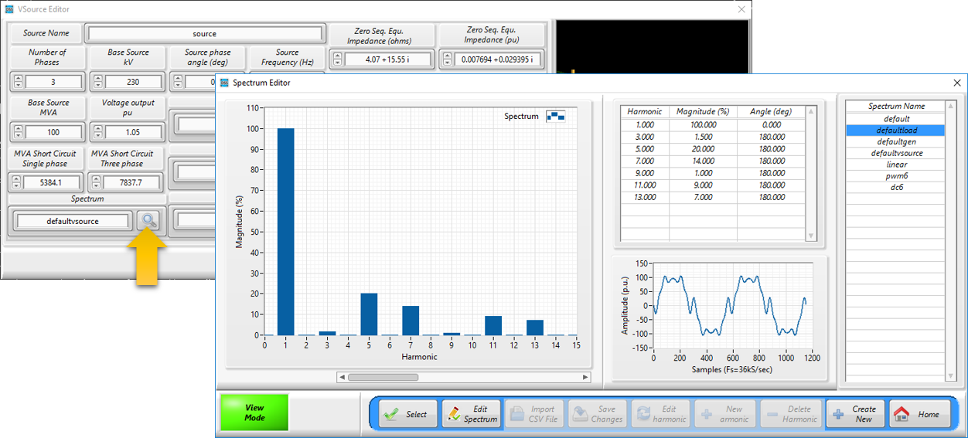
Creating the model from the scratch

Slide 31
Creating the model from the scratch
Rules:
Connect your PD/PCElement to an existing bus
Follow the instructions

Slide 32
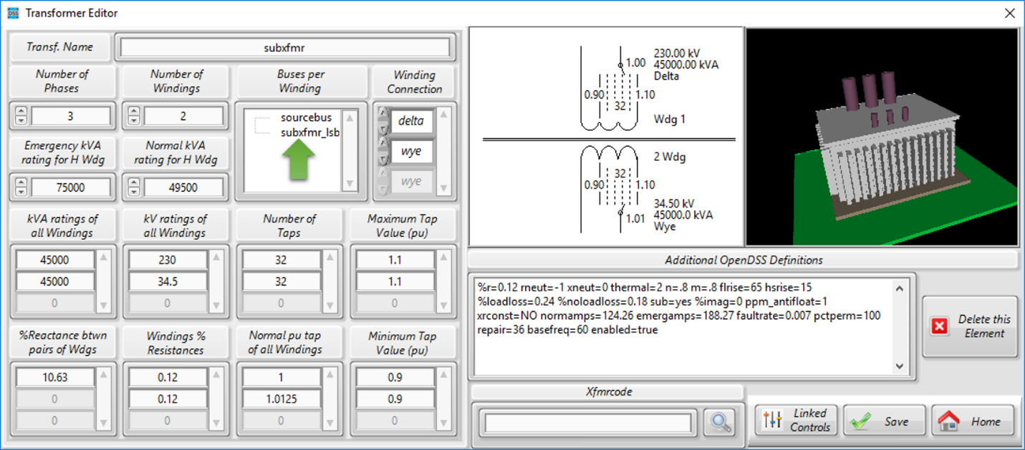
Creating the model from the scratch
Transformers (special case):

Slide 33
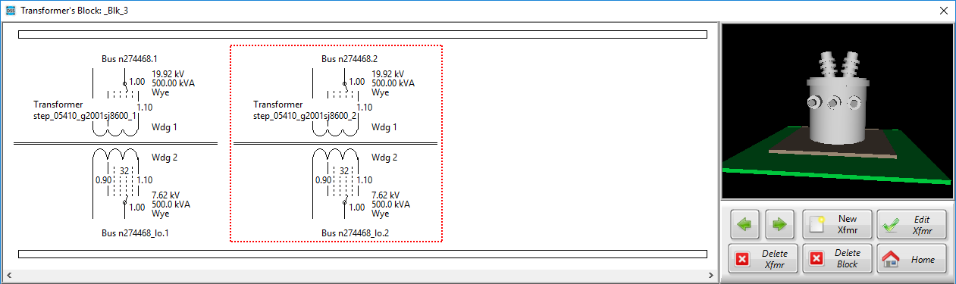
Creating the model from the scratch
Transformers (special case):

Slide 34
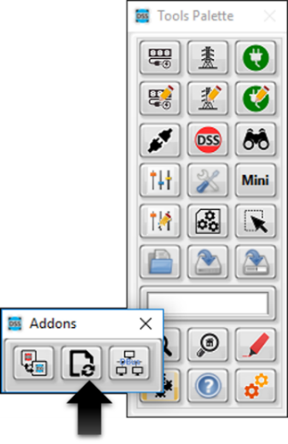
Other possibilities
Update your model (DSSim-PC)

Slide 35


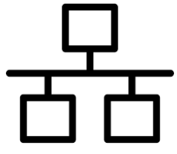
Co-Simulation
OpenDSS-G Incorporates a TCP server for distributed applications

Slide 36
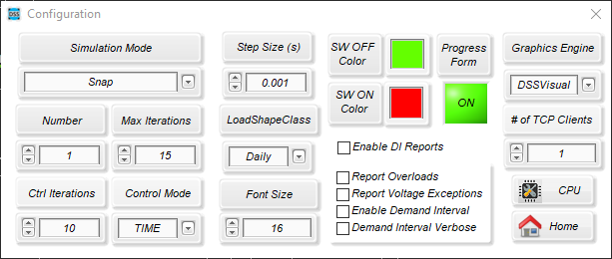
Co-Simulation

Slide 37
Co-Simulation
Documentation:
https://sourceforge.net/projects/dssimpc/files/Documents/DSTCP-Comm.pdf/download
https://sourceforge.net/projects/dssimpc/files/Documents/MATLAB_Lib.pdf/download

Slide 38
Changing the language of your local installation

Slide 39
Changing the language of your local installation
Documentation:
https://sourceforge.net/projects/dssimpc/files/Documents/Changing_the_language_of_OpenDSS-G.pdf/download
https://sourceforge.net/projects/dssimpc/files/Documents/Changing_the_language_of_OpenDSS-G-menus.pdf/download

